Slide 1
PRIDE Study Document Retrieval Problem
Nathan Edwards
Department of Biochemistry and
Molecular & Cellular Biology
Georgetown University Medical Center

Slide 2
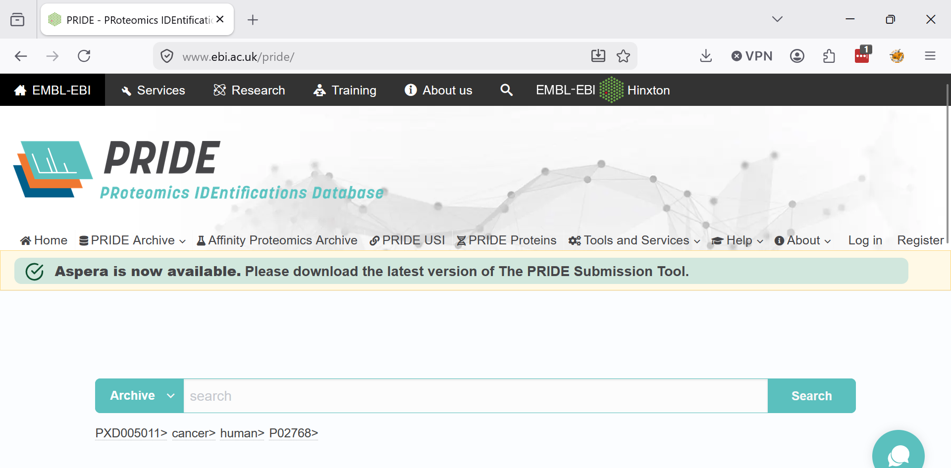
PRIDE Proteomics Resource

Slide 3
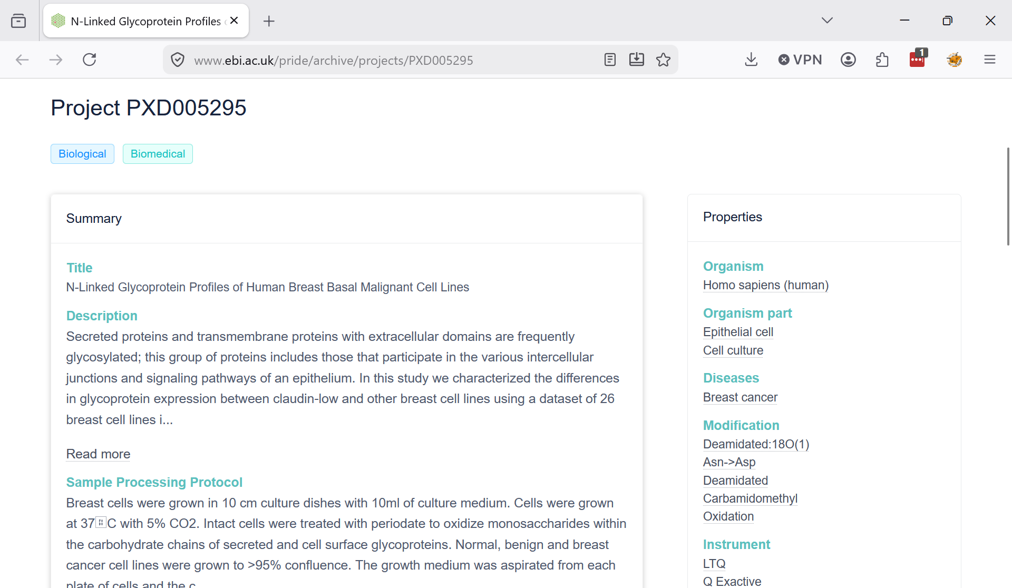
PRIDE Proteomics Resource

Slide 4
PRIDE Proteomics Resource
PRIDE provides considerable metadata about its studies and an API for search
Some metadata is explicitly modeled, but the rest is free-text descriptions:
  Title, Description, Sample Processing Protocol, Data Processing Protocol, Keywords
We want to find specific types of PRIDE studies for tagging and reprocessing.
  Specific sample preparation and analysis details

Slide 5
N-glycan site analysis
Use PNGase F to cleave N-glycans from their glycoproteins…
  Modifies (deamidates) the Asn residue [+0.98]
Standard proteomics search tools are applied
Asn residues with appropriate modification in the correct sequence motif NX[S/T] represent an N-glycosylation site.
Sometimes PNGase F is just a “cleanup”.
Can we find these studies for reanalysis?

Slide 6
The problem…
36,696 PRIDE Studies (JSON docs)
  ~ 100-200 with PNGase F
“Natural” language descriptions of sample preparation and data processing
~ 80 true positives (manually curated)
Intact glycopeptide analyses (no PNGase F) represent false positives
Can we build a model to find these studies?

Slide 7
Lets see what works!
Keyword document retrieval techniques
  BM25, TF-IDF
Text-embeddings
  OpenAI 3 small + large
Traditional ML techniques
Fine-tuned or zero-shot (Bio)BERT models
Prompt engineering, agentic loops, …

Slide 8
Outcomes
Public repository with data-resources and (some) instructions
GitHub notebooks for Google-Colab
  Python module (in GitHub) to simplify notebooks
Links to large data or in GitHub.
Some insights on good strategies for the problem

Slide 9
Pipeline
Start with True Positive seed studies
  Train/Test split – 20%
Randomly select 25x other studies
TF-IDF fit to train studies only
Logistic regression (LASSO) fit to train studies using text-embeddings and TF-IDF inputs
  Check which words are used by log. reg.
Score all studies with the model

Slide 10
Insights
Embeddings don’t help (much)
  Large vs small embeddings
Word-based strategies pick some good words
  And lots of quite strange words (bx?)
Lots of tuning of parameters would probably help
There are still many relevant studies that remain to be found
  Top study revealed a problem in TP file

Slide 11
Still to come?
Some kind of Gen-AI multi-shot prompt to check the high-scoring studies
  Can’t do this for all studies…
Once we have a good strategy – how can we assign a useful confidence value
  Gen-AI doesn’t do this well
Perhaps we should (instead) focus on identifying good, discriminating words
  Turn the problem on its head…

